Slide 1
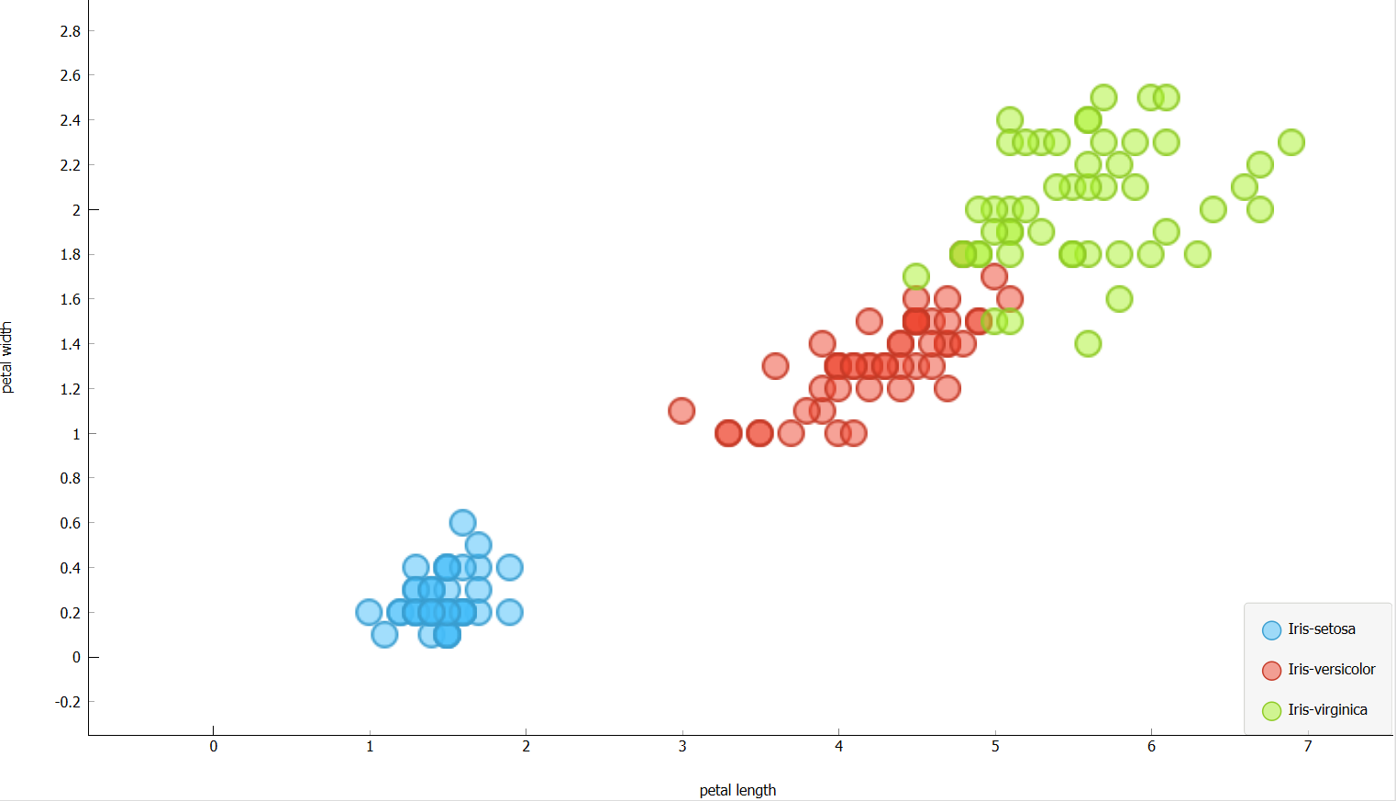
Perceptron Observations
Litha Thampan

Slide 2
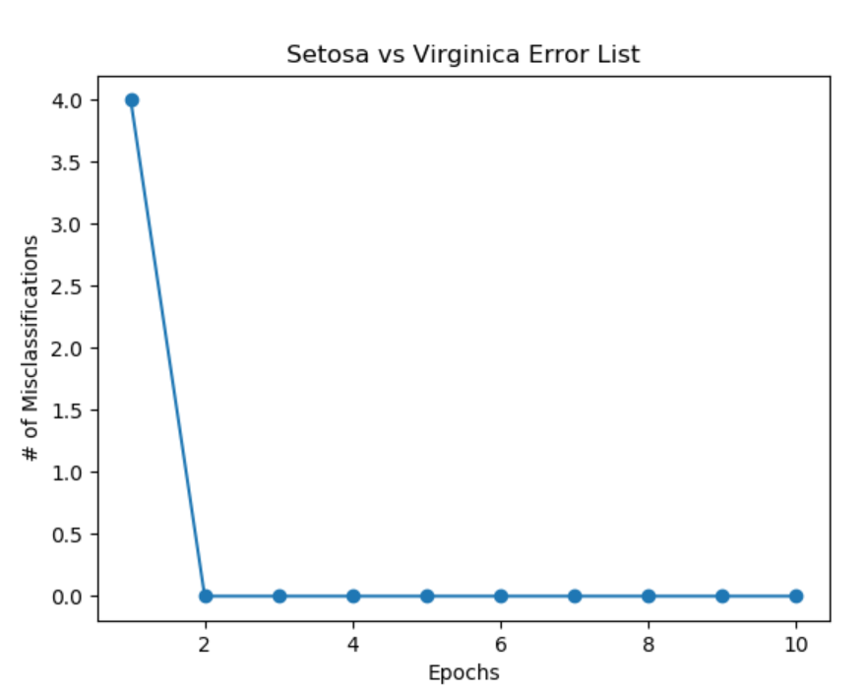
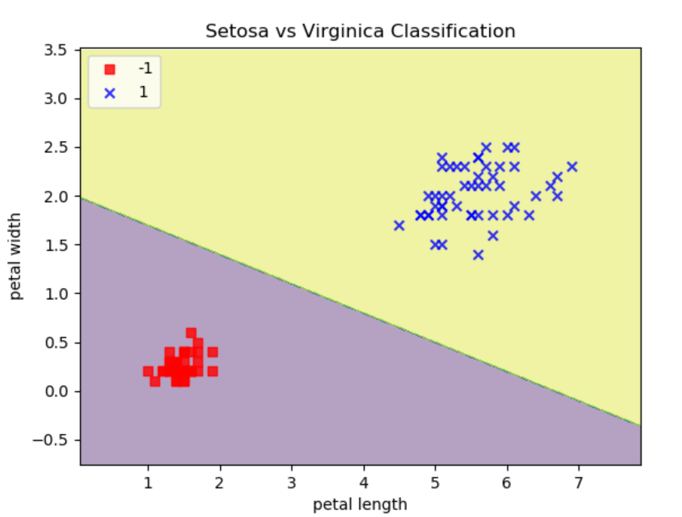
Perceptron Standard
Setosa vs Virginica
Data set is linearly separable
Errors resolved in first few epochs
Less epochs required to find a classification
Once finds an error-free classification , remaining epochs do not change the classification.

Slide 3
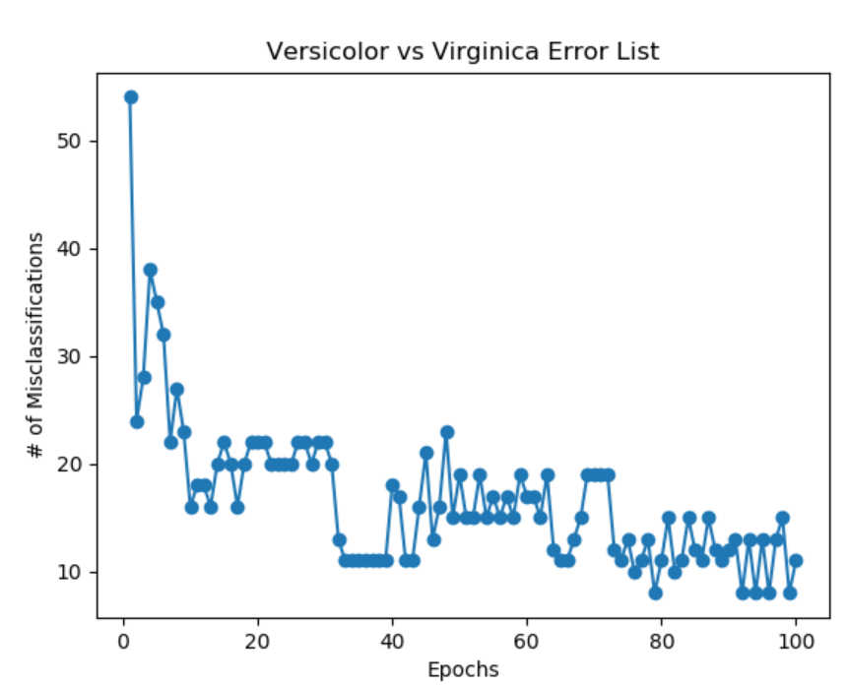
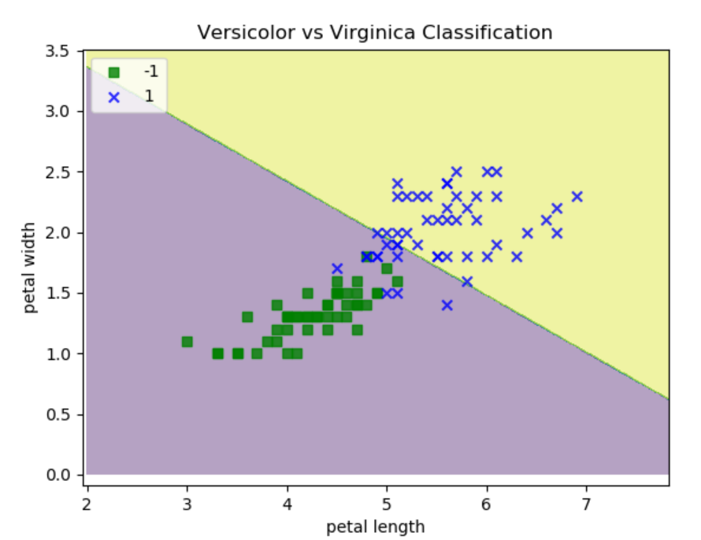
Perceptron Standard
Versicolor vs Virginica
Data set is not linearly separable
Error never resolved completely after 100 epochs
Creates the classification based on the last epoch.

Slide 4
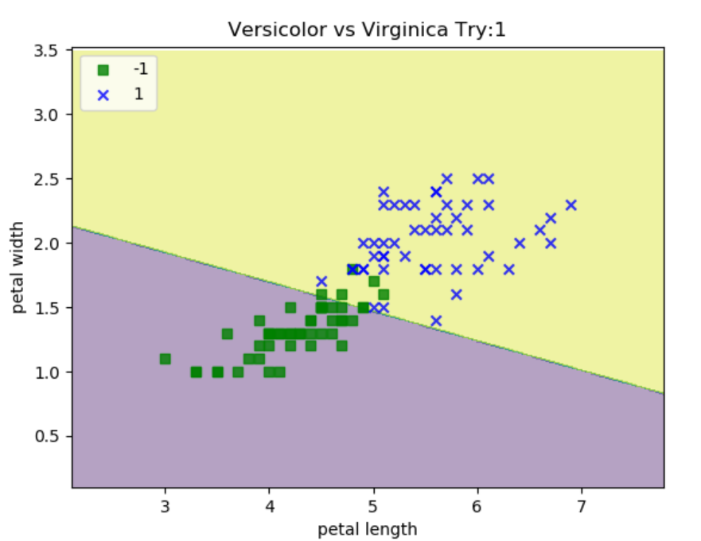
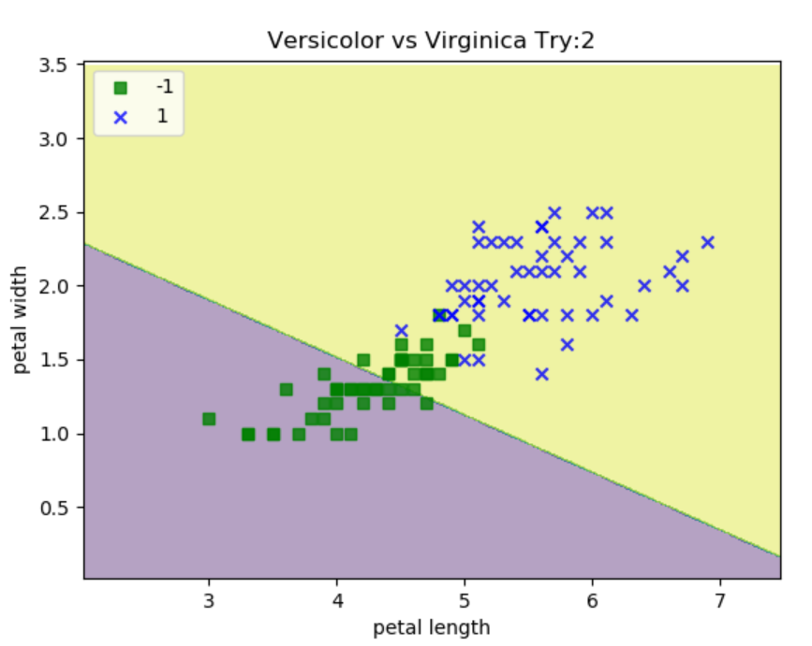
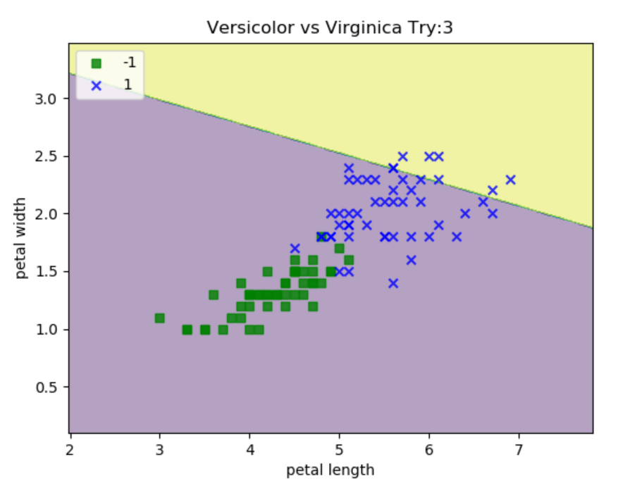
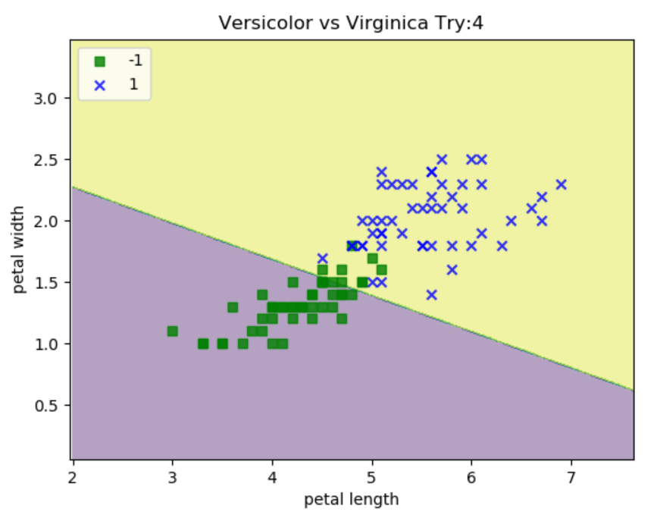
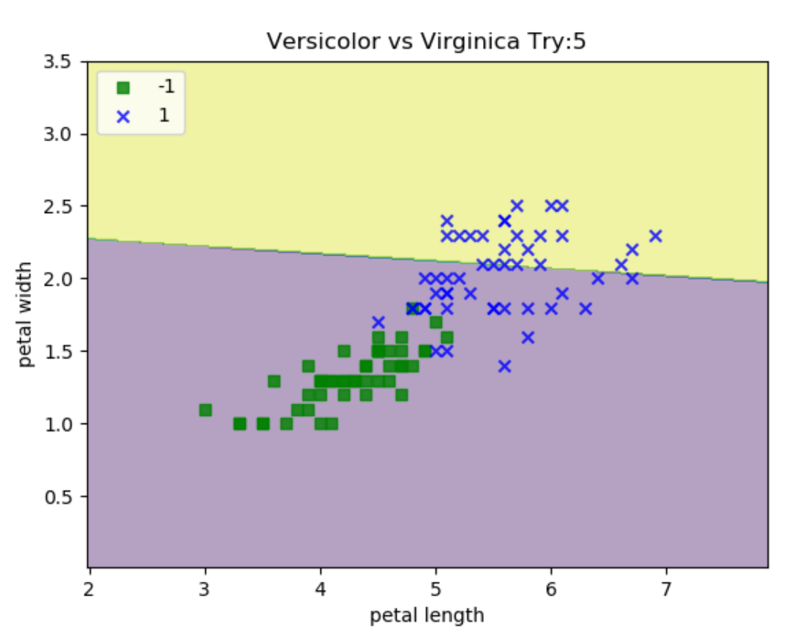
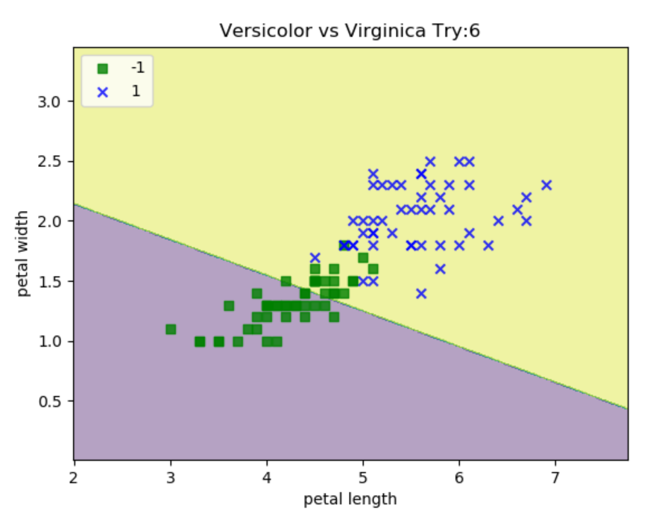
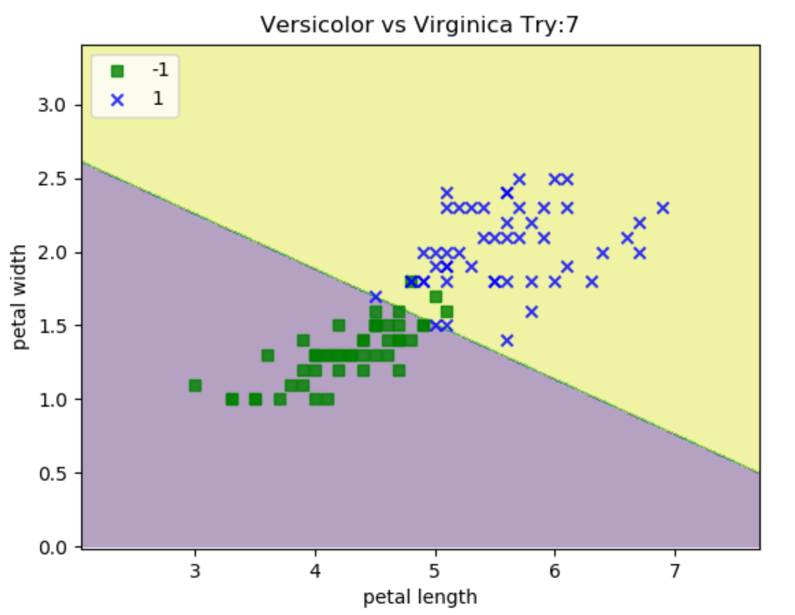
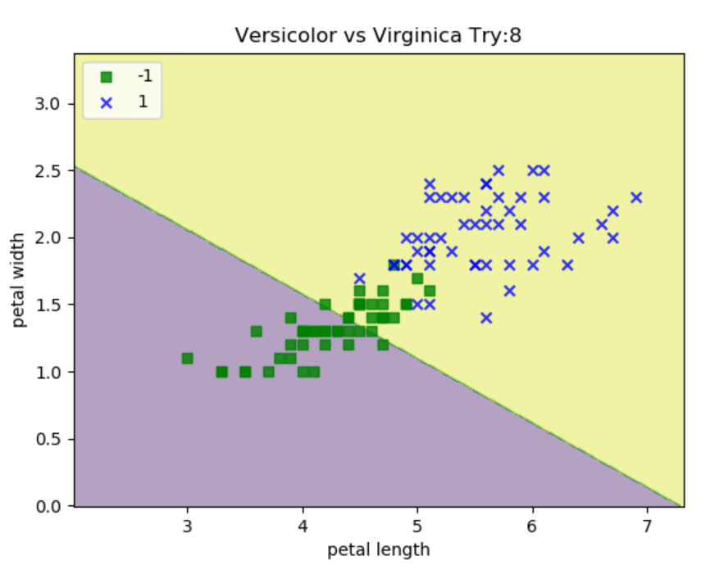
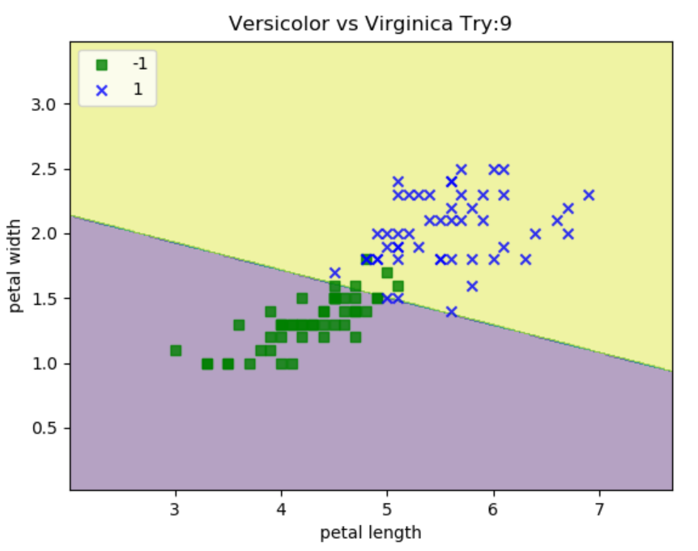
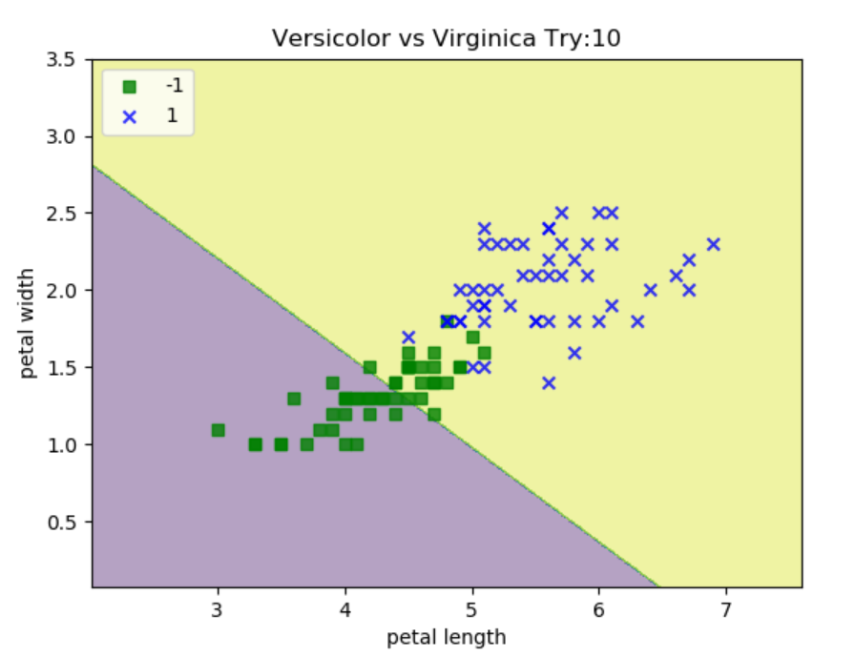
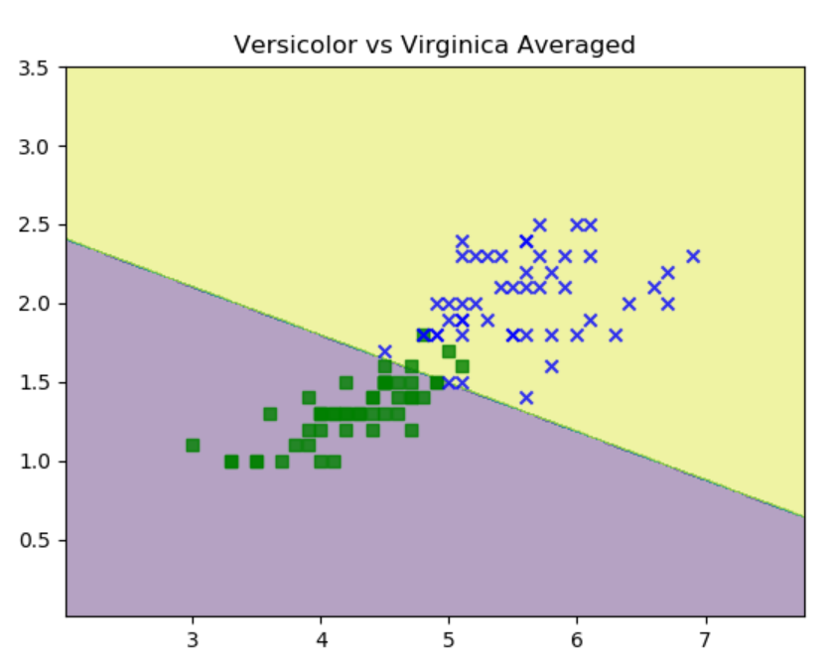
Perceptron Averaged
Versicolor vs Virginica
Data set is not linearly separable
N number of Weights are averaged to get the final classification
Provides a better accuracy compared to standard algorithm due to averaging

